Slide 1
OSTEO ARTHRITIS
Dr. R.S.G.SOWMYA,
Assistant Professor
Dept of Pathology, SKHMC, kulasekharam

Slide 2
Osteoarthritis is a degenerative disease of synovial joints characterized by focal loss of articular hyaline cartilage with proliferation of new bone & remodeling of joint contour.

Slide 3
EPIDEMIOLOGY
Weight bearing joints e.g. knee & hip joints.
Age > 65 years.
  80% have radiographic features.
  25-30% have symptoms.
More common in women.
Familial tendency.

Slide 4
AETIOLOGY
PRIMARY / IDIOPATHIC:
When there is no obvious predisposing factor. Common form of OA.
SECONDARY:
When degenerative joint changes occur in response to a recognizable local or systemic factor.

Slide 5
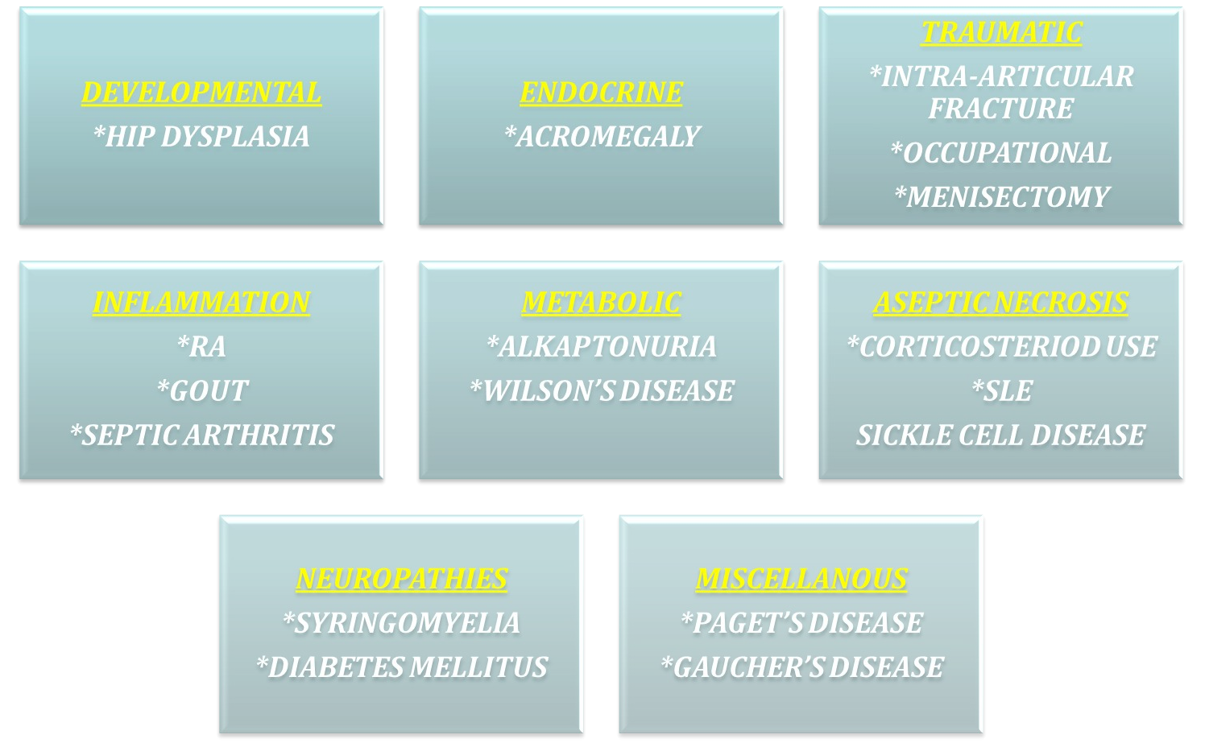
Causes of secondary OA

Slide 6
RISK FACTORS
AGING
CONSTITUTIONAL SUSCEPTIBILITY
Hereditary
Gender / Harmonal status
Obesity
High bone mineral density

Slide 7
MECHANICAL CAUSE
Trauma
Joint shape
Alignment
Usage
Occupational
Recrational

Slide 8
PATHOGENESIS
Progressive destruction & loss of articular cartilage with an accompanying peri-articular bone response leads to exposure of sub-chondral bone which becomes sclerotic, with increased blood vascularity & cyst formation.

Slide 9
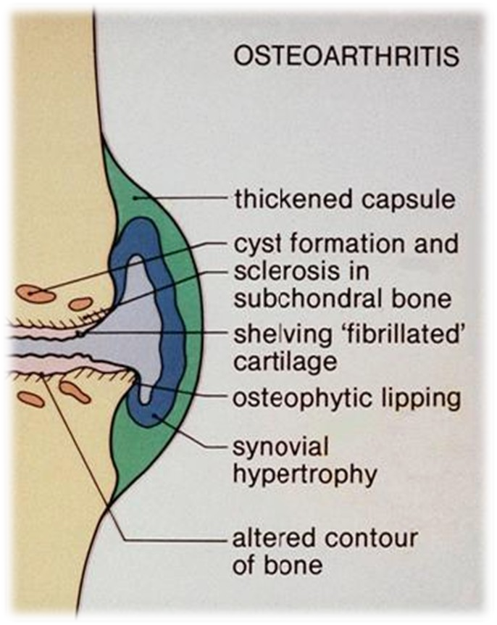

Slide 10
CLINICAL FEATURES
Pain:
  Activity & weight-bearing related, relieved by rest.
  Variable over time.
  Only one or few joints involved.
Morning stiffness only brief
<30 minutes.
Restricted functionality:
  Capsular thickening.
  Blocking by osteophytes.

Slide 11
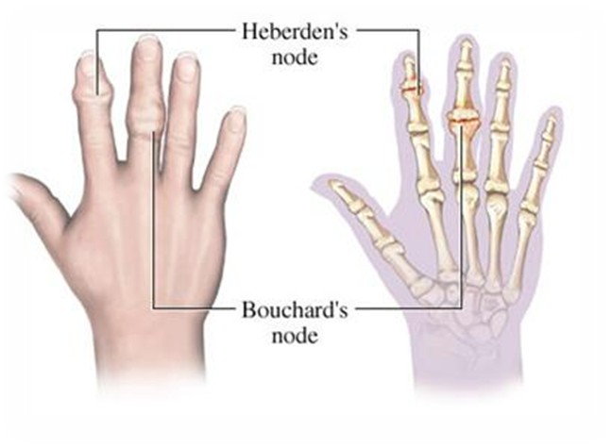
CLINICAL FINDINGS IN NODAL GENERALIZED OA
Presentation typically in women. (40 & 50 years)
Pain.
Stiffness.
•
Swelling of one or few finger interphalangeal joints ( distal > proximal).
•
Heberden’s nodes (+/- Bouchard’s nodes).
•
Involvement of first carpometacarpal joint is common.
•
Predisposition to OA at other joints specially knees.

Slide 12
CLINICAL FINDINGS IN KNEE OA
Targets patello-femoral & medial tibio-femoral compartments of knee.
Pain is localized to anterior or medial aspect of knee & upper tibia.
•
Jerky gait.
•
Varus deformity.
•
Joint line &/or periarticular tenderness.
•
Weakness & wasting of quadriceps muscle.
Restricted extension & flexion.
Bony swelling around joint.

Slide 13
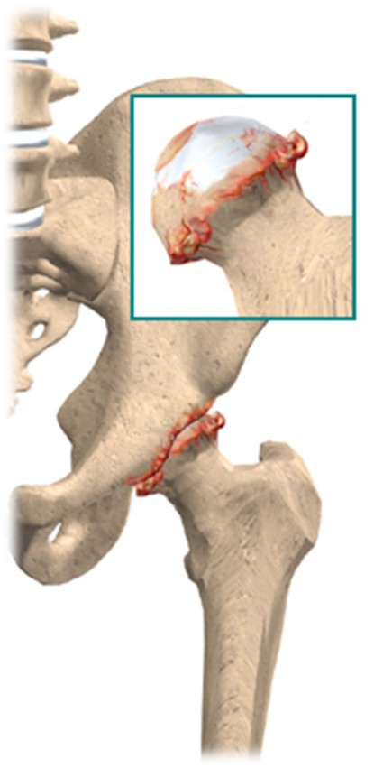
CLINICAL FINDINGS IN HIP OA
•
Targets mostly superior aspect & less commonly medial aspect of joint.
•
Pain is maximally deep in groin area.
•
Antalgic gait.
•
Weakness & wasting of muscles (quadriceps & gluteal).
Pain & restricted internal rotation with flexion.

Slide 14
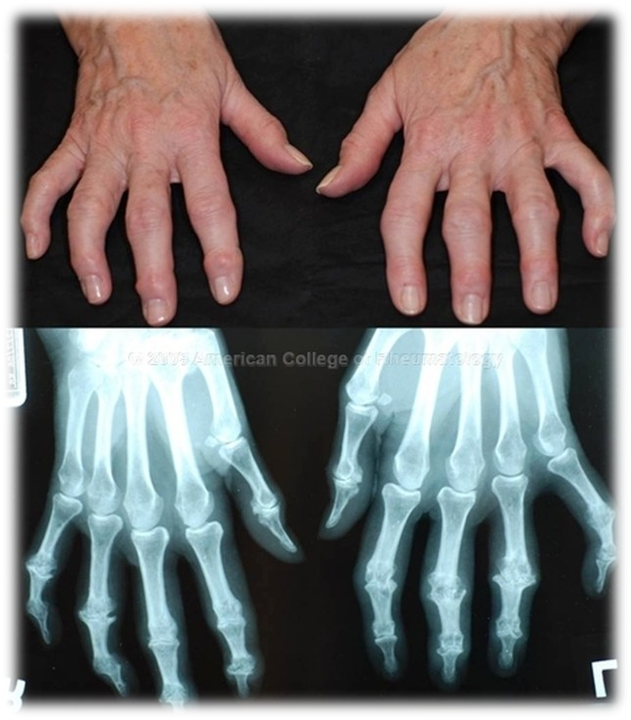
CLINICAL FEATURES IN EROSIVE OA
Preferentially targeting proximal IPJs.
Common development of IPJ lateral instability.
•
Sub-chondral erosions on x-rays.
•
Ankylosis of IPJs.

Slide 15
INVESTIGATIONS
PLAIN X-RAY:
  JOINT SPACE NARROWING
  SUBCHONDRAL SCLEROSIS

Slide 16
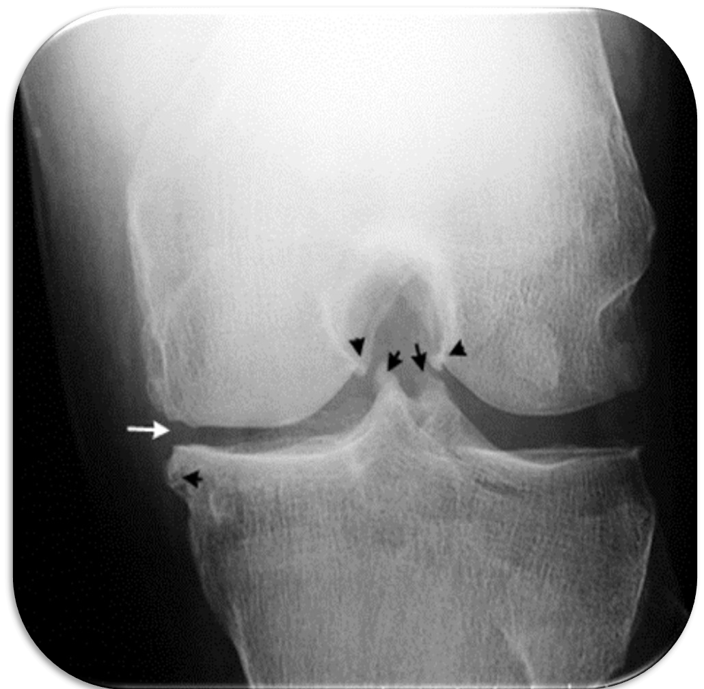
MARGINAL OSTEOPHYTES

Slide 17
INVESTIGATIONS
BLOOD TEST:
FBC
ESR
CRP
NORMAL. NORMAL. NORMAL.
– RHEUMATOID FACTOR NEGATIVE.
SYNOVIAL FLUID ANALYSIS:
  VISCOUS WITH LOW TURBIDITY.
  CPPD & CALCIUM PHOSPHATE.

Slide 18
Full explanation of the condition via patient education:
  Properly position and support your neck and back while sitting or sleeping.
  Adjust furniture, such as raising a chair or toilet seat.
  Avoid repeated motions of the joint, especially frequent bending.
  Lose weight if you are overweight or obese, which can reduce pain and slow progression of OA.
  Exercise each day.
  Build confidence.

Slide 19
Exercises:
  Aerobic conditioning.
  Muscle strengthening exercises.
Reduction of adverse mechanical factors:
  Weight loss.
  Pacing of activities.
  Appropriate footwear.

Slide 20
SURGICAL TREATMENT
Should be considered for those who do not give response to pharmacotherapy.
  Osteotomy.
  Joint replacement.
  Total joint replacement.

Slide 21
GOUT

Slide 22
Crystal arthritis
Deposition of uric acid crystals in joints
Presents with acute monoarticular arthritis in 90 % of patients.
Men > Women
• Onset 40-60 years
Very treatable
Untreated, may lead to chronic tophaceous gout.

Slide 23
URIC ACID METABOLISM
Nucleic Acids
Hypoxanthine
Xanthine Oxidase
Xanthine
Xanthine Oxidase
Uric Acid
Excretion by Kidney

Slide 24
Uric Acid Metabolism
Nucleic Acids
Hypoxanthine
Xanthine Oxidase
Xanthine
Xanthine Oxidase
Uric Acid
Excretion by Kidney

Slide 25
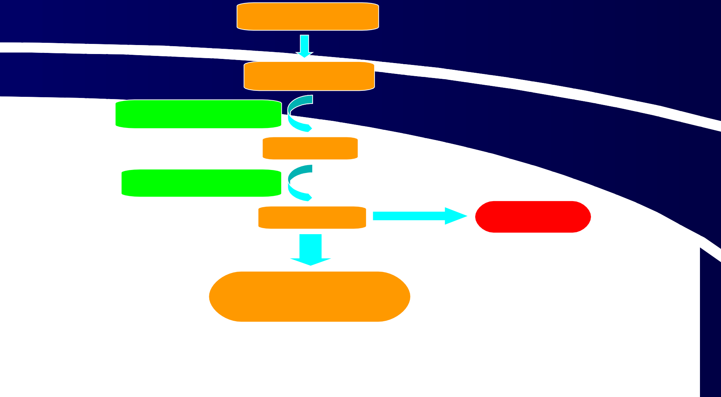
ng?
What goes wrong
Increased nucleic
acids
Nucleic Acids
Hypoxanthine Xanthine Oxidase
Xanthine
Xanthine Oxidase
Uric Acid
GOUT
Excretion by Kidney
Impaired renal excretion

Slide 26
Predisposing Factors
Male>Female
Family History
Previous attack
Body size - large > small
Alcohol
Diet – purine rich
Diuretics
Causes of high cell turnover e.g. psoriasis, chemotherapy
Renal insufficiency

Slide 27
Investigation
Joint Aspiration – Polarising light
microscopy for crystals
FBC - white cells raised
ESR - raised
X-ray - generally normal
• Serum urate
HIGH SERUM URATE DOES NOT NECESSARILY MEAN THE PATIENT HAS GOUT!

Slide 28
Chronic Tophaceous Gout
If gout untreated
Other joint involvement
Formation of tophi- collection of crystals in soft tissues
• Bone erosion at joints- ‘punched out’ erosions on x-ray.

Slide 29
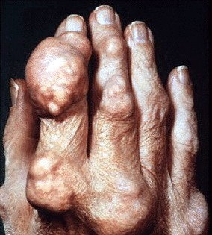
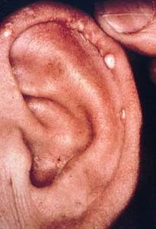
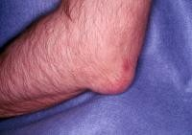
TOPHI

Slide 30
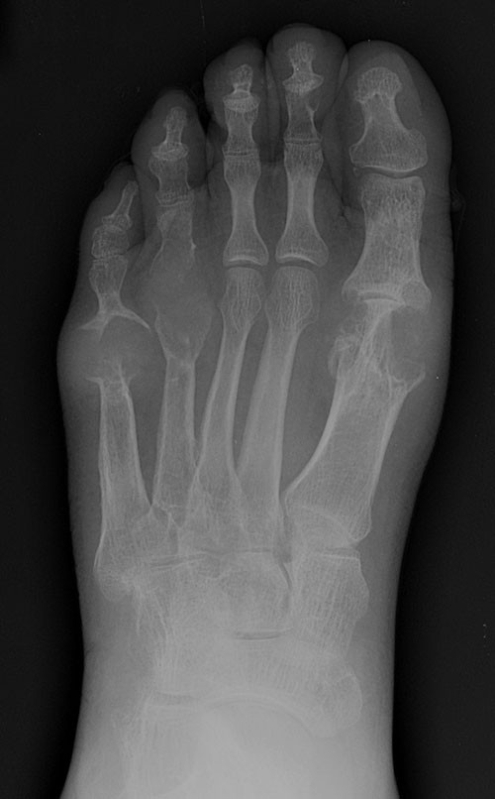
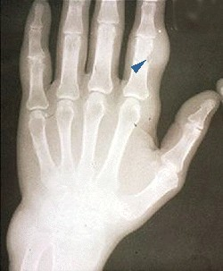
X-RAYS

Slide 31
Reference
Harsh Mohan Text Book of Pathology
Robbins & Cotran Pathologic Basis of Disease

